Slide 1



Slide 2
About this presentation (remove this slide before presenting)
Please make use of the speaker notes (View > Notes). They are there to help the people presenting this slide deck bring the messaging to life – we hope you find them helpful.
Please credit Carers UK and the Power of Attorney Day campaign if you use any of this content elsewhere. We've left space in the presentation for you to add your own organisation specific information.
If you have any feedback please get in touch: powerofattorneyday@carersuk.org
This presentation has been prepared by the national charity Carers UK as part of their UK wide Power of Attorney Day campaign, delivered in partnership with Standard Life.
It is designed to support organisations across the UK to talk to their staff and other stakeholders about power of attorney.
We want you to use this presentation and the notes provided to talk confidently about power of attorney, be able to answer common concerns and questions, and signpost people on to next steps.

Slide 3

What is a power of attorney?
A power of attorney is a legal document that lets you appoint someone to make legal decisions or take actions on your behalf should a time come when you are unable to.
Notes:
It’s simple!
Some people call it a 'living will' - allowing you to make sure your wishes are followed if something happens to you and you are without capacity

Slide 4

Why does it matter?
We tend to assume that 'next of kin' will automatically be allowed to make decisions on our behalf if something happens to us. This isn’t true.
Without power of attorney, it is not certain who can take decisions on your behalf. With power of attorney in place, you can be confident that you have taken the necessary steps to make everything as clear-cut as possible.
Notes:
We never know what’s around the corner.
Serious health events can also happen out of the blue, and they're not necessarily permanent.
It's best to be prepared – a power of attorney is the best way of doing this!

Slide 5
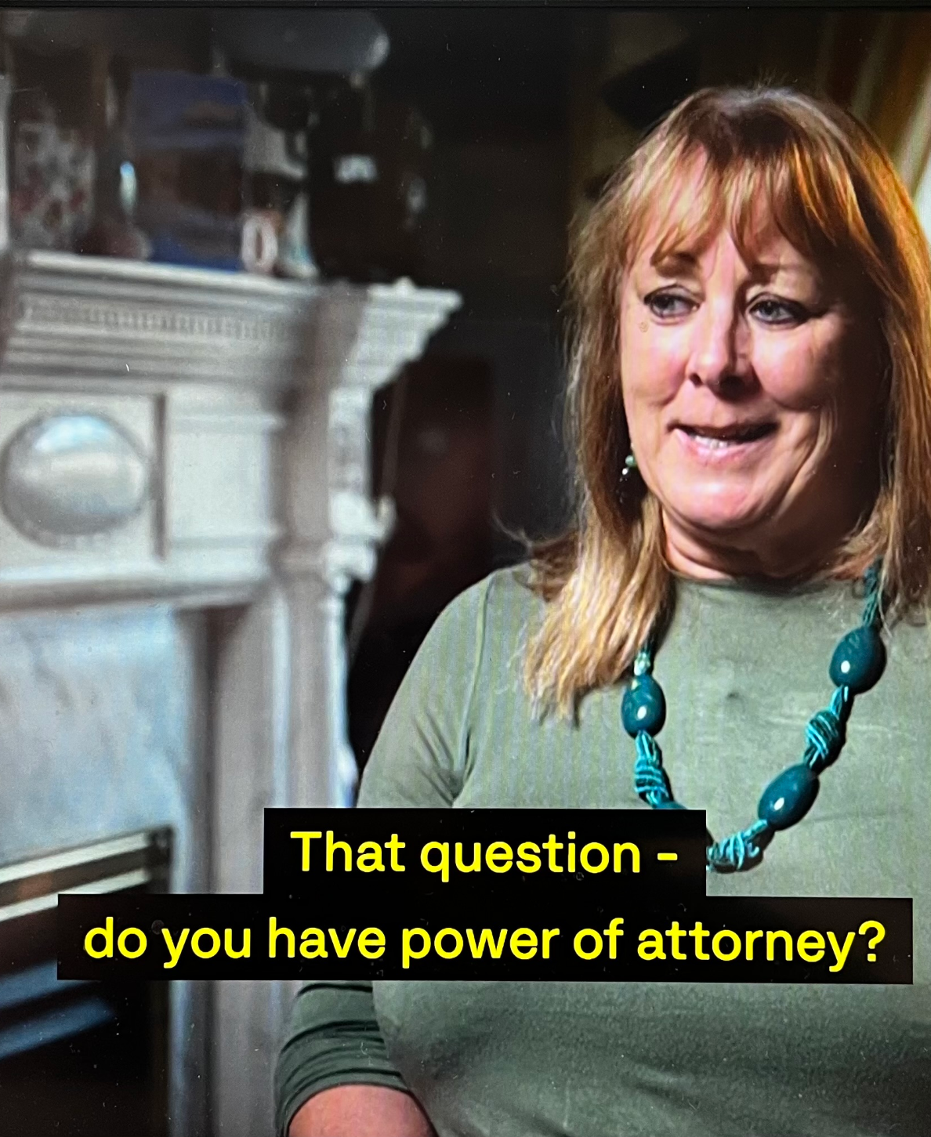
Dorothy's story
"If there's one regret I have it's not putting power of attorney in place soon enough."
Dorothy cared for her husband, Melvin, for 17 years until he died in June 2025. Melvin had ataxia, a degenerative neurological condition, and as his health deteriorated, Dorothy gave up work to support him, providing round-the-clock care.
Dorothy did not have power of attorney for Melvin and, following a hospital admission, Dorothy found that she was not able to overrule a decision regarding Melvin's discharge.
Notes:
This was the experience of Dorothy – she and her husband had put off putting power of attorney in place, until it was too late
Only having a Health and Welfare power of attorney gives you the clear right to decide about health and welfare decisions on someone's behalf
You can read more case studies on the dedicated Power of Attorney Day website www.powerofattorneyday.org.uk under "Experiences"

Slide 6
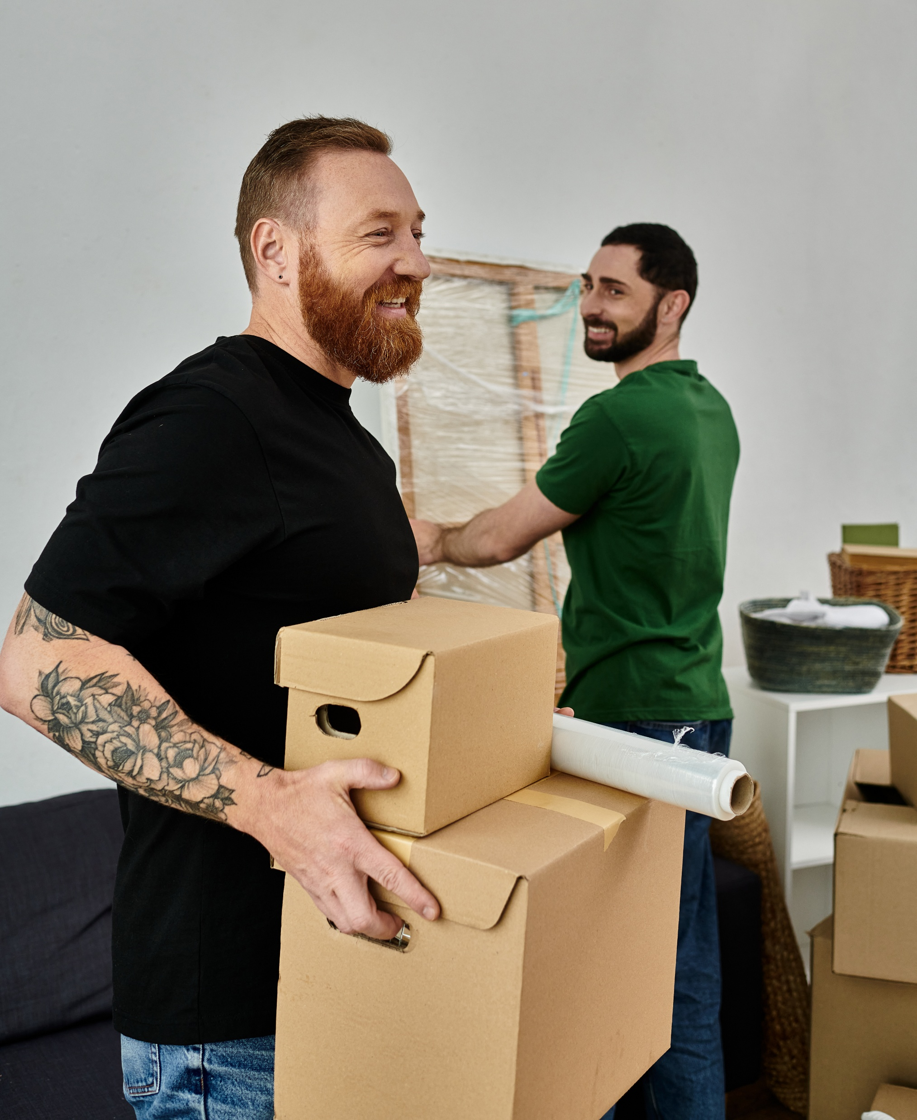
Who can get one?
Any adult (18+ in England and Wales and Northern Ireland, and 16+ in Scotland) with the mental capacity to understand what they are signing can make a power of attorney.
You do not need to be elderly or unwell – just able to make your own decisions at the time of signing.
Notes:
People should be thinking about them as part of life planning – when buying a house, getting married, making big financial decisions etc.
The best time to think about a power of attorney is before you actually need one - while you’re healthy, have capacity, and are not under pressure.
Think about getting the ball rolling today …

Slide 7
Is it different in different parts of the UK?
England and Wales have Lasting Power of Attorney (LPA). There are two different types: Property and Financial Affairs LPA and Health and Welfare LPA. ​
Scotland has Continuing Power of Attorney for property and finances and Welfare Power of Attorney for health and
personal welfare. These are often combined into
one document and referred to as Power of Attorney (POA). ​
Northern Ireland has enduring power of attorney (EPA). This only covers property and financial affairs.
Notes:
Yes. But it's not that complicated!
There are different types of power of attorney in England and Wales, Scotland, and Northern Ireland.
They can be used across borders, aka you can use a Scottish POA in England and vice versa.

Slide 8

How much does it cost?
To register a power of attorney
In England and Wales: £92 per LPA
In Scotland: £96 per PoA (however if you register both together it's still £96)
In Northern Ireland: £180 to register an EPA
Some people could qualify for fee reductions: Visit the Power of Attorney Day website for more details

Slide 9

Do I need to use a solicitor?
In England, Wales and Northern Ireland, some people use a solicitor to help prepare the forms and fees will vary. ​
In Scotland you do not strictly need a solicitor to draft a Power of Attorney (PoA) but you must have a solicitor or a qualified medical doctor sign a Schedule 1 certificate to certify that you understand the document.
Notes:
Not necessarily! Especially in England and Wales where many people have found it perfectly easy to prepare and register the documentation themselves.

Slide 10

How do I start the conversation?
Conversations with loved ones about power of attorney need to be handled carefully and at the right time.
Carers UK's conversation starter document offers great guidance and tips: powerofattorneyday.org.uk/media/s30pgpva/poa-conversation-starter.pdf
Notes:
We know there are often many emotions that can prevent us even considering putting a power of attorney in place.
However, the practical support and emotional relief in the long-term cannot be underestimated.
It's best to start these conversations in good time – use the Carers UK Conversation Starter document to help prepare and get talking

Slide 11
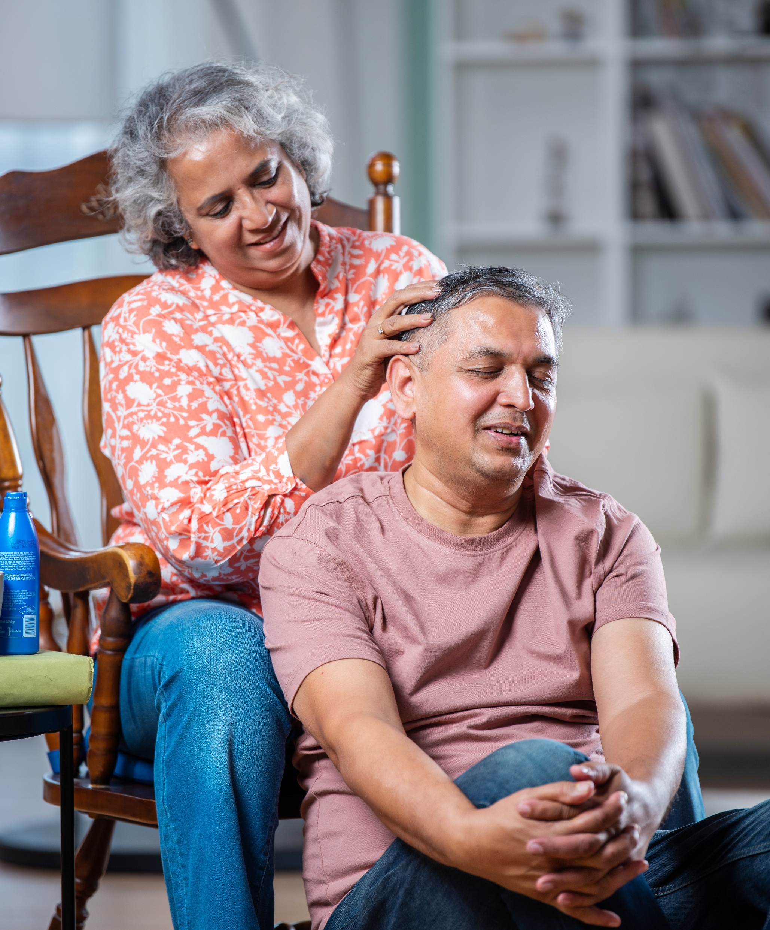
What other options are there?
A power of attorney may not always be possible or appropriate. What else can I consider?
Deputyship
Third-party mandate
Appointeeship
Advance statement / advance decision
Will planning
Notes:
Power of attorney may not be suitable for all (eg, for managing the affairs of a child without mental capacity) and other options are available.
IMPORTANT: If it's too late to put a power of attorney in place and families / loved ones have to apply for a court order, it can be very expensive.
This is why, if power of attorney is suitable, it's best to put it in place in good time.

Slide 12

Sources of support:
Power of Attorney Day website
powerofattorneyday.org.uk
Power of Attorney Day resources
powerofattorneyday.org.uk/resources
Guides, videos and factsheets: Guides and tools | Carers UK
Carers UK Helpline
advice@carersuk.org

Slide 13
Space for you / your organisation to add your own information and sources of support:
Add your content here

Slide 14

Discussion points
What situations can you imagine needing to use a power of attorney?
What might hold you back from putting a power of attorney in place for yourself?
What might hold a loved one back from putting a power of attorney in place?
How do you think increased knowledge and uptake of power of attorney might help our workforce / customers / wider stakeholders?
Notes:
These questions are designed to inspire discussion and sharing
Please feel free to add your own

Slide 15

Next steps:
If you want to get going now …
If you’re in England or Wales visit gov.uk/power-of-attorney
If you’re in Scotland visit mygov.scot/power-of-attorney
If you’re in Northern Ireland visit nidirect.gov.uk/articles/managing-your-affairs-and-enduring-power-attorney

Slide 16

Stay informed and involved:
powerofattorneyday.org.uk

